Slide 1



The Maximum and Minimum Price Sum Problem
This presentation explores a classic dynamic programming problem: finding the maximum and minimum price sum within a given set of prices. We'll dive into the problem, analyze the solution using dynamic programming, and discuss its implications.
by Aiswariya R

Slide 2


Aim
The goal is to develop an efficient algorithm that calculates the maximum and minimum price sums achievable from a given array of prices.
Maximum Price Sum
Minimum Price Sum
Finding the highest possible total price that can be attained.
Determining the lowest possible total price that can be obtained.

Slide 3
Defining Maximum and Minimum Price Sum
Imagine a list of prices for different items. We want to find the maximum sum of prices we can achieve by selecting a subset of these items. Similarly, we need to find the minimum sum of prices possible from the same set.
Maximum Sum
Minimum Sum
The sum of the prices of a selected subset that yields the highest total value.
The sum of the prices of a selected subset that results in the lowest total value.

Slide 4

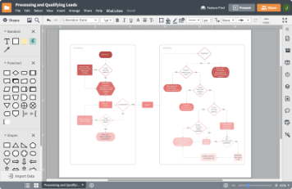
Approach Using Dynamic Programming
Dynamic programming is a powerful technique for solving problems by breaking them down into smaller overlapping subproblems. We'll use it to find the maximum and minimum price sums.
Initialization
Result
We initialize a table to store the calculated maximum and minimum sums for different subproblems.
The final entries in the table will contain the maximum and minimum price sums.
1
2
3
Iteration
Iterate through the prices and update the table based on the previous calculations.

Slide 5

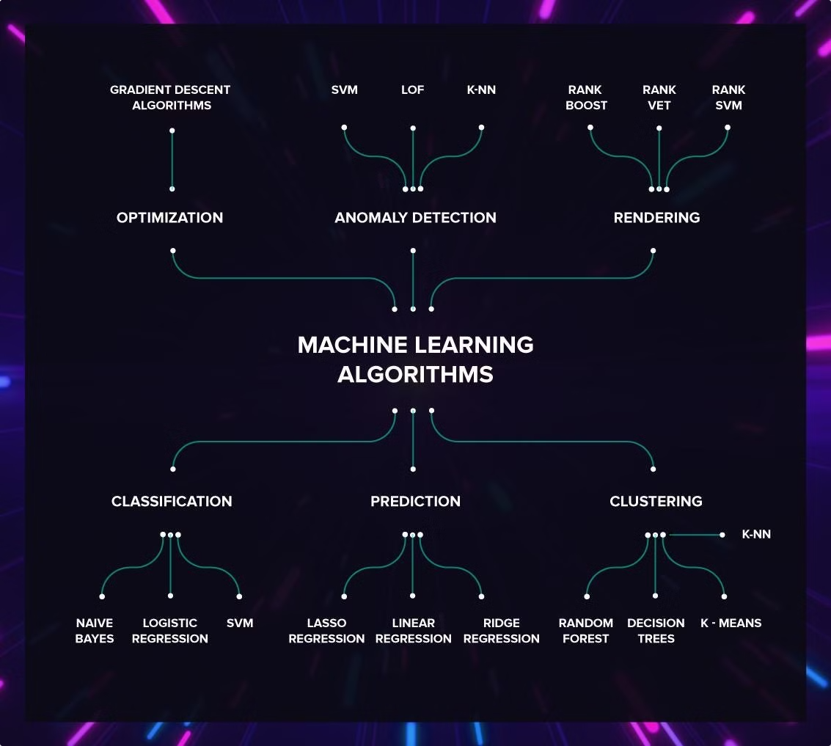



Calculating the Maximum Price Sum
We calculate the maximum price sum iteratively. For each price, we consider whether to include it in the current subset or not. We choose the option that maximizes the current sum.
Base Case
The maximum price sum for the first element is the price itself.
Recursive Step
For each subsequent price, we consider the maximum between including it and excluding it.
Final Result
The last element in the table contains the maximum price sum.

Slide 6

Calculating the Minimum Price Sum
The minimum price sum calculation is similar to the maximum sum, but we choose the option that minimizes the current sum.
Base Case
The minimum price sum for the first element is the price itself.
Recursive Step
For each subsequent price, we consider the minimum between including it and excluding it.
Final Result
The last element in the table contains the minimum price sum.

Slide 7

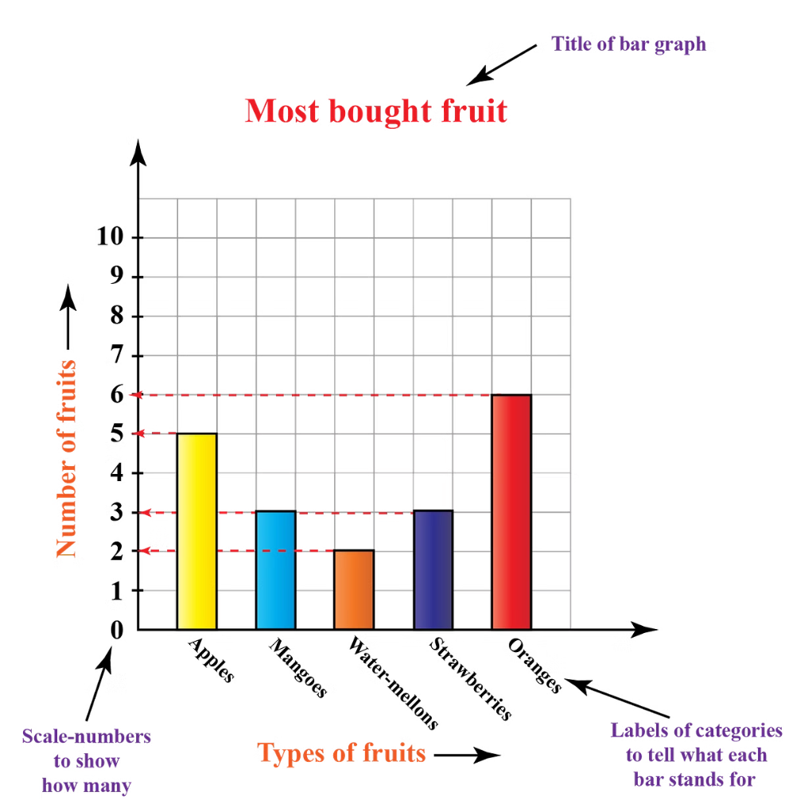
Comparison and Implications
The difference between the maximum and minimum price sums reveals the range of possibilities within the set of prices. This difference can be useful for analyzing price fluctuations and making informed decisions.
1
Price Volatility
2
Investment Strategies
A large difference indicates a higher degree of price volatility.
This information can be used to optimize investment strategies based on risk tolerance.
3
Market Analysis
The difference can help understand price trends and identify potential opportunities.

Slide 8

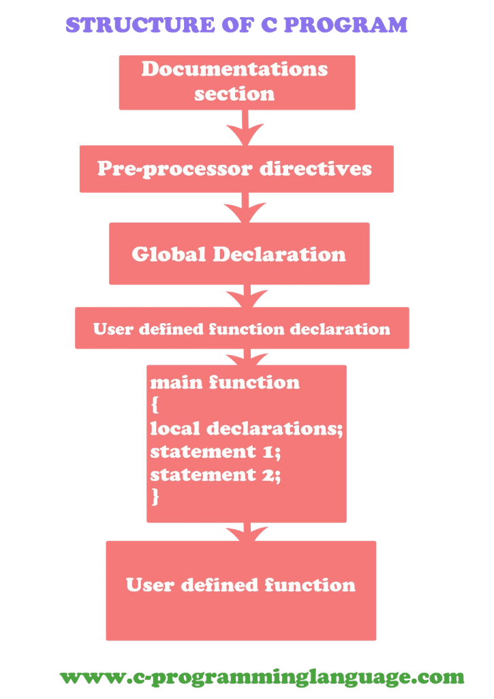
Algorithm in C Programming
Here's a C program implementation of the dynamic programming approach to find the maximum and minimum price sums:
#include <stdio.h> int main() { int prices[] = {10, 20, 30, 40, 50}; int n = sizeof(prices) / sizeof(prices[0]); int maxSum[n], minSum[n]; maxSum[0] = prices[0]; minSum[0] = prices[0]; for (int i = 1; i < n; i++) { maxSum[i] = max(maxSum[i - 1], prices[i]); minSum[i] = min(minSum[i - 1], prices[i]); } printf("Maximum price sum: %d\n", maxSum[n - 1]); printf("Minimum price sum: %d\n", minSum[n - 1]); return 0; }

Slide 9





Conclusion
We've successfully explored the maximum and minimum price sum problem, demonstrating the effectiveness of dynamic programming for efficiently finding optimal solutions.
Efficient Algorithm
Dynamic programming provides a time-efficient approach to solve the problem.
Understanding price volatility and potential for optimization.
Versatility in applying the technique to other problems.

Slide 10


References and Future Scope
Further research can explore extensions of the problem, such as considering constraints on the number of items selected or incorporating different price relationships.
GeeksforGeeks: Dynamic Programming

